Slide 1
$how me the money! Know your worth / the business side of sports chiropractic
Dr. Alan Sokoloff

Slide 3
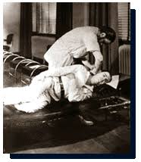
The History of Getting Paid in Sports Chiropractic
FREE!!!!

Slide 4
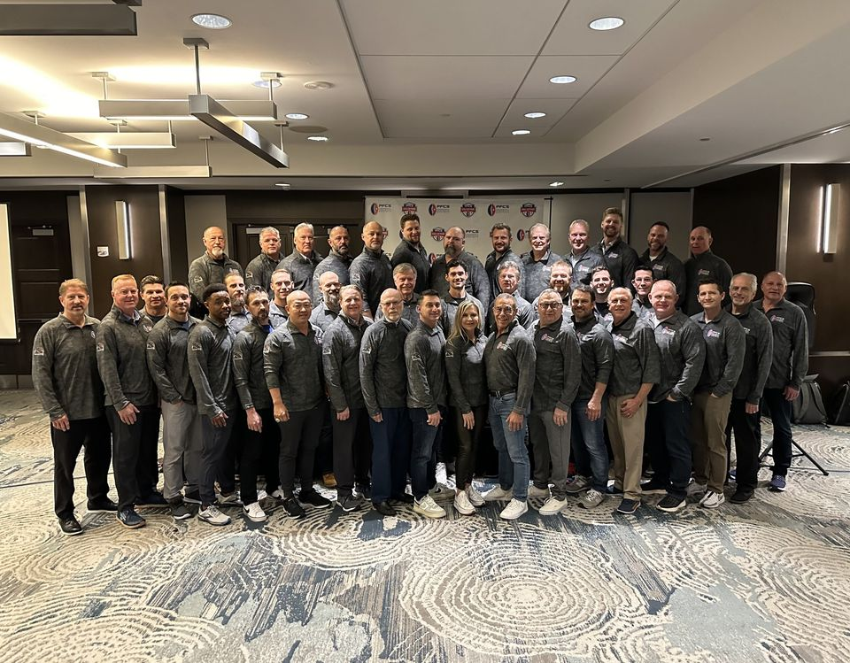
It’s a Rumor
“Most DCs in the NFL provide chiropractic care for free because they like working in NFL”
Notes:
- no one in professional sports does it for free! CLICK for DO NOT

Slide 5
Time = Money

Slide 6
Reimbursement Options
Contract / RFP
Retainer / Fee for the Season
Bill to the Team or University (self insured)
Bill to the Athlete’s Insurance
Bill the School’s / Team Insurance
Bill to the Worker’s Comp Insurance
Combinations work too!
Notes:
Example House call for player’s wife. Awkward situation if fees not established ahead of time.

Slide 7
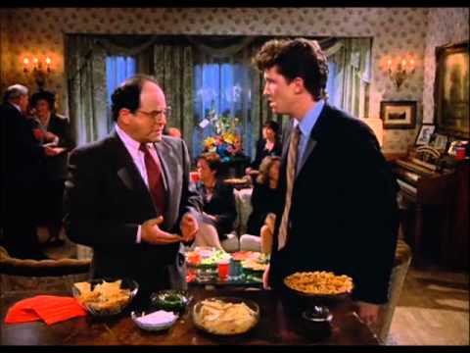
But do not double dip…

Slide 8
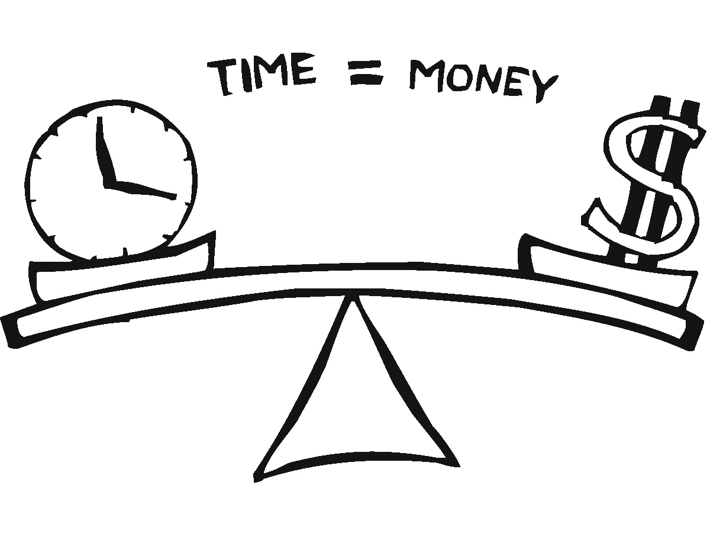
What is your time worth?

Slide 9
Calculating What Your Time Is Worth

Slide 10
Example of What to Consider
Half an hour to get to the location
One hour of service
Half hour to drive back to the office/home
How many patients do you see in in your office in 2 hours
Example: See 6 patients in an hour at average rate of $52.00 per patient
= about $300.00 an hour
Notes:
Half hour to get there -want one hour- Now how many patients do you see in 2 hours 52.00 a patient (6) in an hour=CLICK 300.00 per hour

Slide 11
Reimbursement Rule #1
Fees should be predetermined!

Slide 12
Create a Fee Schedule
Office Location vs. Site Visit
Notes:
Expound

Slide 13
Payment in Kind

Slide 14
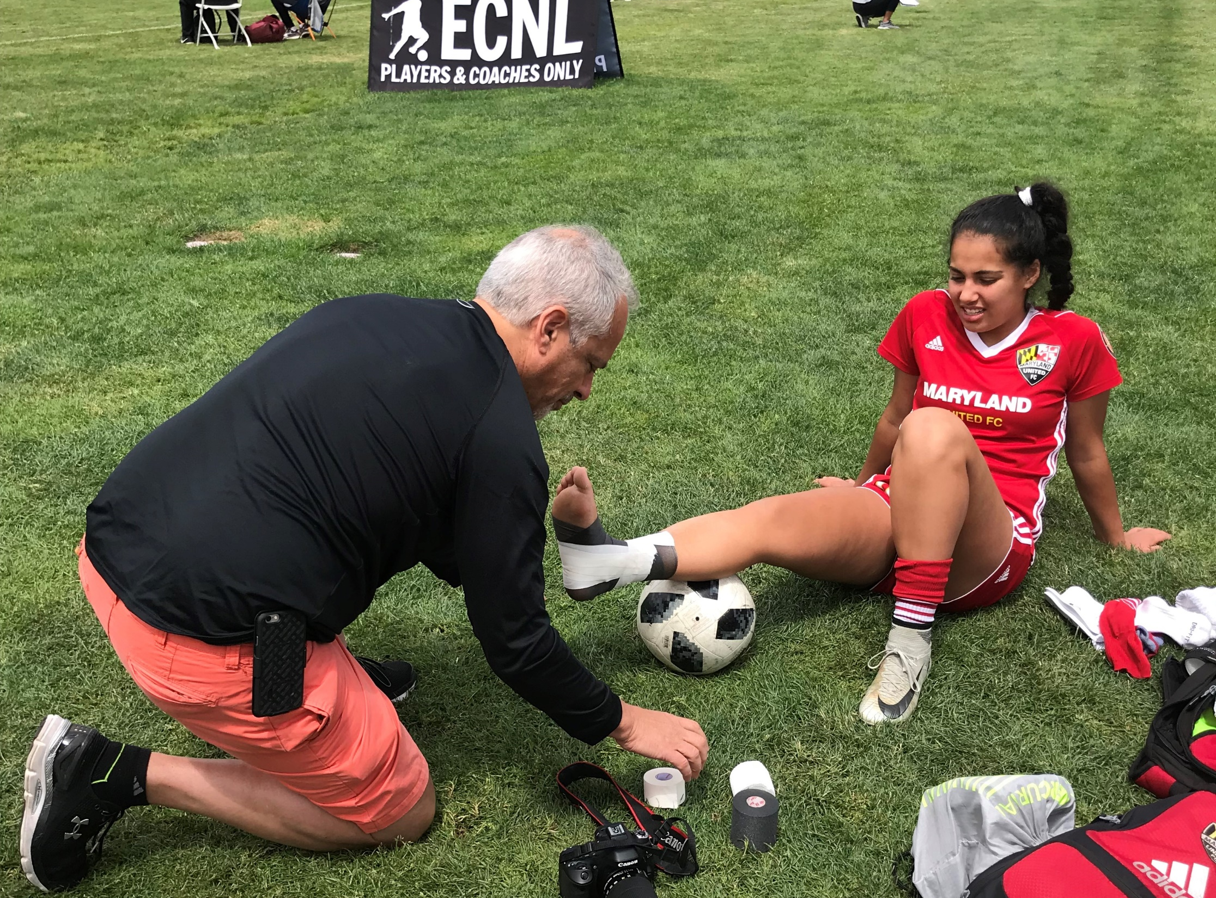

Slide 15
Contracts

Slide 16
“No deal is better than a bad deal.”
Chris Voss
Notes:
Walk away- don’t get stuck

Slide 17
Some Items all Contracts Should Include:
Scope of Work / Obligations
Length of Contract / Renewal
Reimbursement Amount / Terms of Payment
Who to Bill and How
Documentation and communication
Notes:
All your obligations
Start and stop times for the season / off season …
Who can provide the service? Just you?
Malpractice limitations / riders
When and where
Travel to treat. Travel expenses.
Termination
Intellectual property

Slide 18
Should also include…
All your time obligations
Start and stop dates for the year, season
Who can provide services? Is it just you?
Malpractice limitations / riders
When and where you cover

Slide 19
As well as…
Documentation
Termination provisions
Travel expenses
Intellectual property
Indemnity and liability

Slide 21
At The End Of The Day, What Do You Want
Notes:
Ego, Name dropping- reputation for the entire profession- do a good job
Common goal to help the team achieve their peak performance

Slide 22
Key Takeaways
Show me the money!
Calculate your worth
Have a solid contract in writing

Slide 23
Thank you…

Slide 24
Dr. Sok’s Sixteen Steps to Success in Sports Chiropractic
Leave Your Ego at the Door
The Players Are Not Your Patients
Know Who is in Charge
Do Letters Matter
Know Your Team
Keep it Simple
Stay in Your Lane
Documentation & Communication
Treatment Recommendations
Health History
Managing Time
Your Schedule
Location
What Should You Bring
Compensation
Are You Prepared

